Slide 1

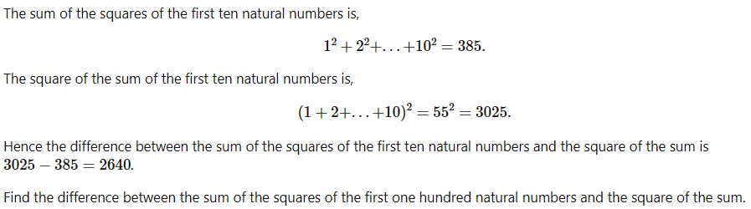
Power Digit Sum VERY EASY
Sum Square Difference EASY
Leap Year Checker MEDIUM
Make a program that checks an inputted year is a leap year or not.
Conditions for a leap year:
Divisible by 4
Not Divisible by 100, but can be divisible by 400
To test if your program works, enter the test data given below:
2020 => Leap year
1600 => Leap year
1000 => Not leap year
1998 => Not leap year
2017 => Not leap year
Most Frequent Number In An Array HARD
Given an unsorted array of numbers, between 1 to 5 (inclusive), find the most frequent number and the frequency of that number.
There’s only one number that is the most frequent.
The array:
[3, 4, 3, 2, 2, 1, 2, 5, 3, 4, 1, 2, 5, 2, 3, 3, 1, 4, 3, 1, 2, 5, 4, 2]
Hint:
This number can be done in multiple ways, but some ways are less efficient. One way it can be done is by sorting the array first, using array.sort().
Harder challenge on next slide

Slide 2

Summation of Primes

Slide 3
Solutions next slides

Slide 4
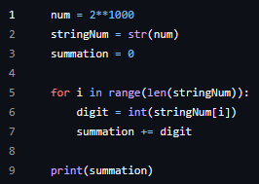
Power Digit Sum VERY EASY
Answer: 1366
Code:

Slide 5
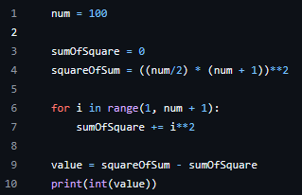
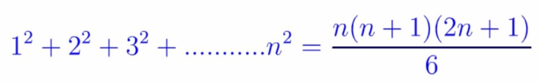
Sum Square Difference EASY
Answer: 25164150
Code:
Square of sum is done using the equation but can be done using the same for loop. Sum of squares can also be done with an equation, rather than the for loop for constant time complexity, but the equation is only taught in A-Level maths.

Slide 6
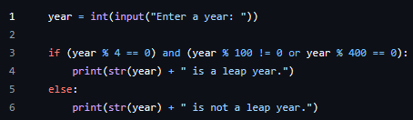
Leap Year Checker MEDIUM
Code:

Slide 7
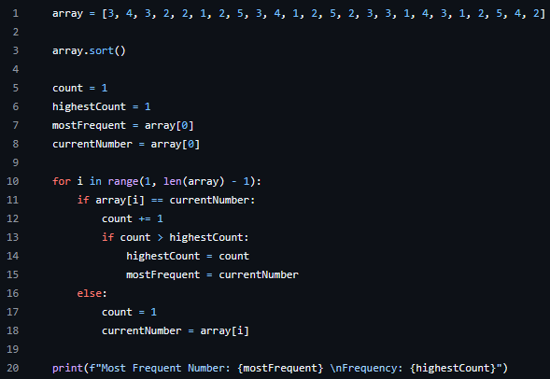
Most Frequent Number In An Array HARD
Answer:
Most Frequent Number: 2
Frequency: 7
Code:
Can be done with a dictionary or hash table

Slide 8
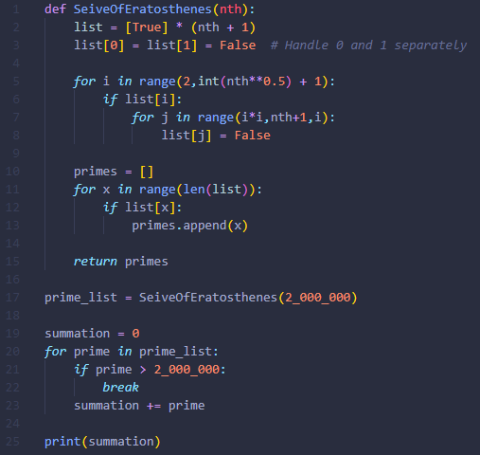
Summation of Primes
May not work in some programming languages, since we are creating a list with 2,000,001 elements.
Answer: 142913828922
My code:
Syntax is somewhat inconsistent, since I wrote this a while ago

